Slide 1
Evaluation of Microservice Architecture Designs in an IoT-Context
Abramov Sviatoslav svyatabram@gmail.com
Supervisor: Prof. Dr.-Ing Günter Schäfer
Supervisor: Associate Prof. Dr. Igor Anikin

Slide 2
Content
Introduction
Requirements
State of the Art
The system overview
Results
Conclusion
Future Work

Slide 3
Introduction

Slide 4
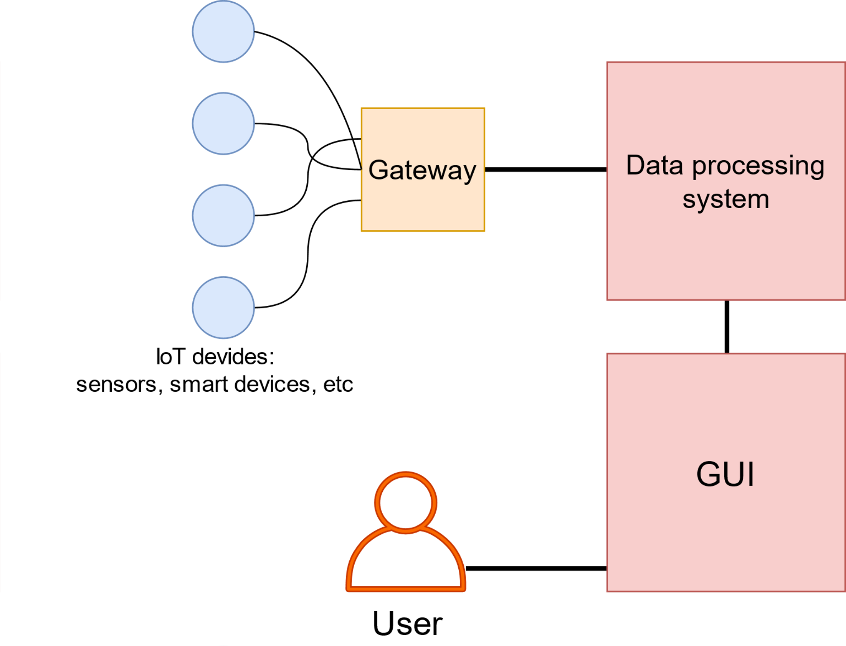
The Internet of Things
IoT architecture elements:
Gateway collects and transports IoT devices data.
DPS is the main data processing part.
GUI represents processed data to end users.
IoT architecture diagram.

Slide 5
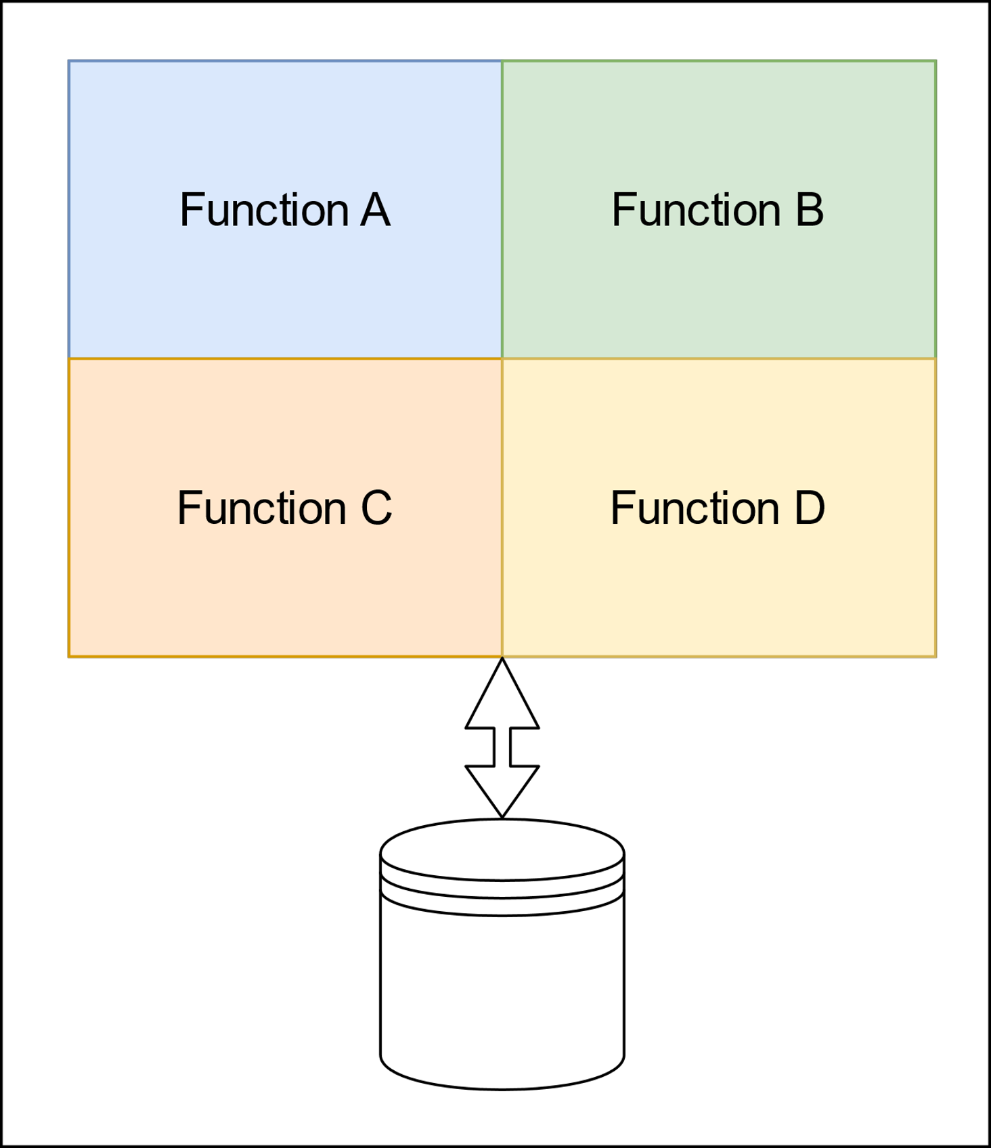
Monolithic architecture
Drawbacks:
Can not be horizontally scaled
Modules share the same memory space
A module bugs affect the whole application
Continuous deployment is almost impossible
Suitable for lightweight and not multifunctional applications.
Monolithic architecture example.

Slide 6
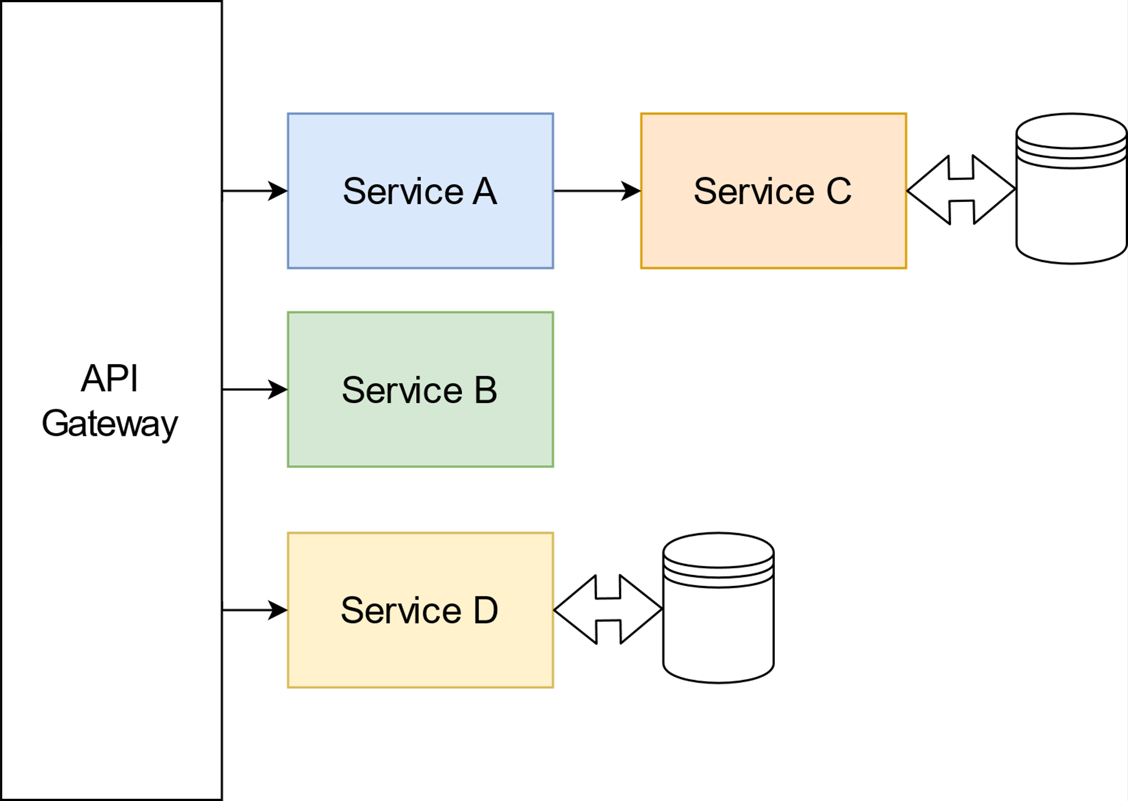
Microservices architecture
Microservices architecture example.

Slide 7
Microservices architecture
Advantages:
Functional decomposition
Each service can be scaled independently
Services do not share the same memory space
Each service is developed independently
Drawbacks:
Complex deploying and testing
Difficult interconnection process
Microservices architecture example.

Slide 8
Microservices architecture
Advantages:
Functional decomposition
Each service can be scaled independently
Services do not share the same memory space
Each service is developed independently
Drawbacks:
Complex deploying and testing
Difficult interconnection process
Microservices architecture example.
Suitable for high-loaded and multifunctional application such as IoT data processing system

Slide 9
The main goal
The main goal is to find the best MSA architecture design in an IoT context.

Slide 10
The main goal
The main goal is to find the best MSA architecture design in an IoT context.
We compared:
Interconnection methods
Database management systems
Load balancing strategies

Slide 11
What we have done
Analyzed the most demanded technologies in MSA context.
Built the MSA application, satisfying the most common requirements.
Developed a load generation, simulating IoT devices.
Implemented a monitoring system
Processed measurements.

Slide 12
Requirements

Slide 13
Functional requirements
Provide connectivity for IoT devices.
Transform IoT device data model to the system data model.

Slide 14
Non-functional Requirements
Qualitative
Testable
Reproducible
Deployable

Slide 15
Non-functional Requirements
Qualitative
Quantitative
Testable
Reproducible
Deployable
Response time
Scalable

Slide 16
State of the art

Slide 17
Basic articles
M. S. Hatem Hamad and R. Abed, “Performance evaluation of restful web services for mobile devices,” Computer Engineering Department, Islamic University of Gaza, Palestine, International Arab Journal of e-Technology, 2010.
In the article advantages of RESTful web services before SOAP web services are shown:
RESTful web services provide less message size.
RESTful web services provide less response time.

Slide 18
Basic articles
P. J. Amaral M. and C. D., “Performance evaluation of microservices architectures using containers.,” IEEE 14th International Symposium on Network Computing and Applications, 2015.
This article shows Server Virtualization provides performance improvement
SV increases server throughput
SV decreases server latency

Slide 19
Basic articles
J. F. Kunhua Zhu and Y. Li, Research the performance testing and performance improvement strategy in web application”, 2nd international Conference on Education Technology and Computer. 2010.
This article provides a survey about overall MSA based application testing :

Slide 20
Basic articles
J. F. Kunhua Zhu and Y. Li, Research the performance testing and performance improvement strategy in web application”, 2nd international Conference on Education Technology and Computer. 2010.
This article provides a survey about overall MSA based application testing :
Functional and load testing of web MSA based web applications basis.
Prediction of an application response time changing with an increasing user load.
User load impact on application throughput.
Possible bottlenecks caused by system utilization.

Slide 21
Not answered questions
Which design chooses we have to made to build MSA system in an IoT-device context?
Which interconnection method fits a certain service functionality better?
How to use load balancing according to services functionality?

Slide 22
The system overview

Slide 23
The system developing
The MS system must provide connectivity, session management, and data model transformation.
Response time is assessment criteria.
The server virtualization and imaging
Load generator simulates a given amount of IoT devices

Slide 24
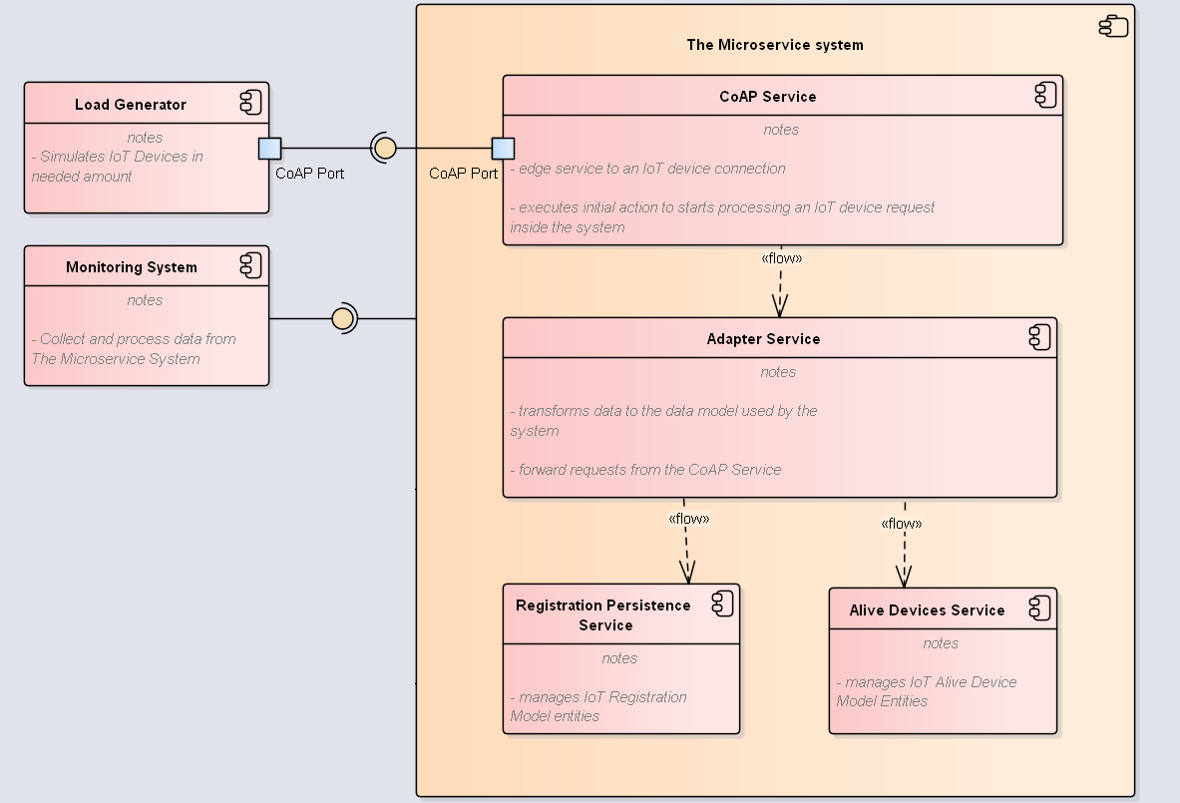
The system developing
The system components diagram.

Slide 25
The system developing
3 service types:
Edge service – CoAP service provides connectivity for IoT devices
Data transformation service – Adapter service generates the system data models for further their processing
Persistence services – Registration and Alive devices persistence service ensure system object storing.
The system components diagram.

Slide 26
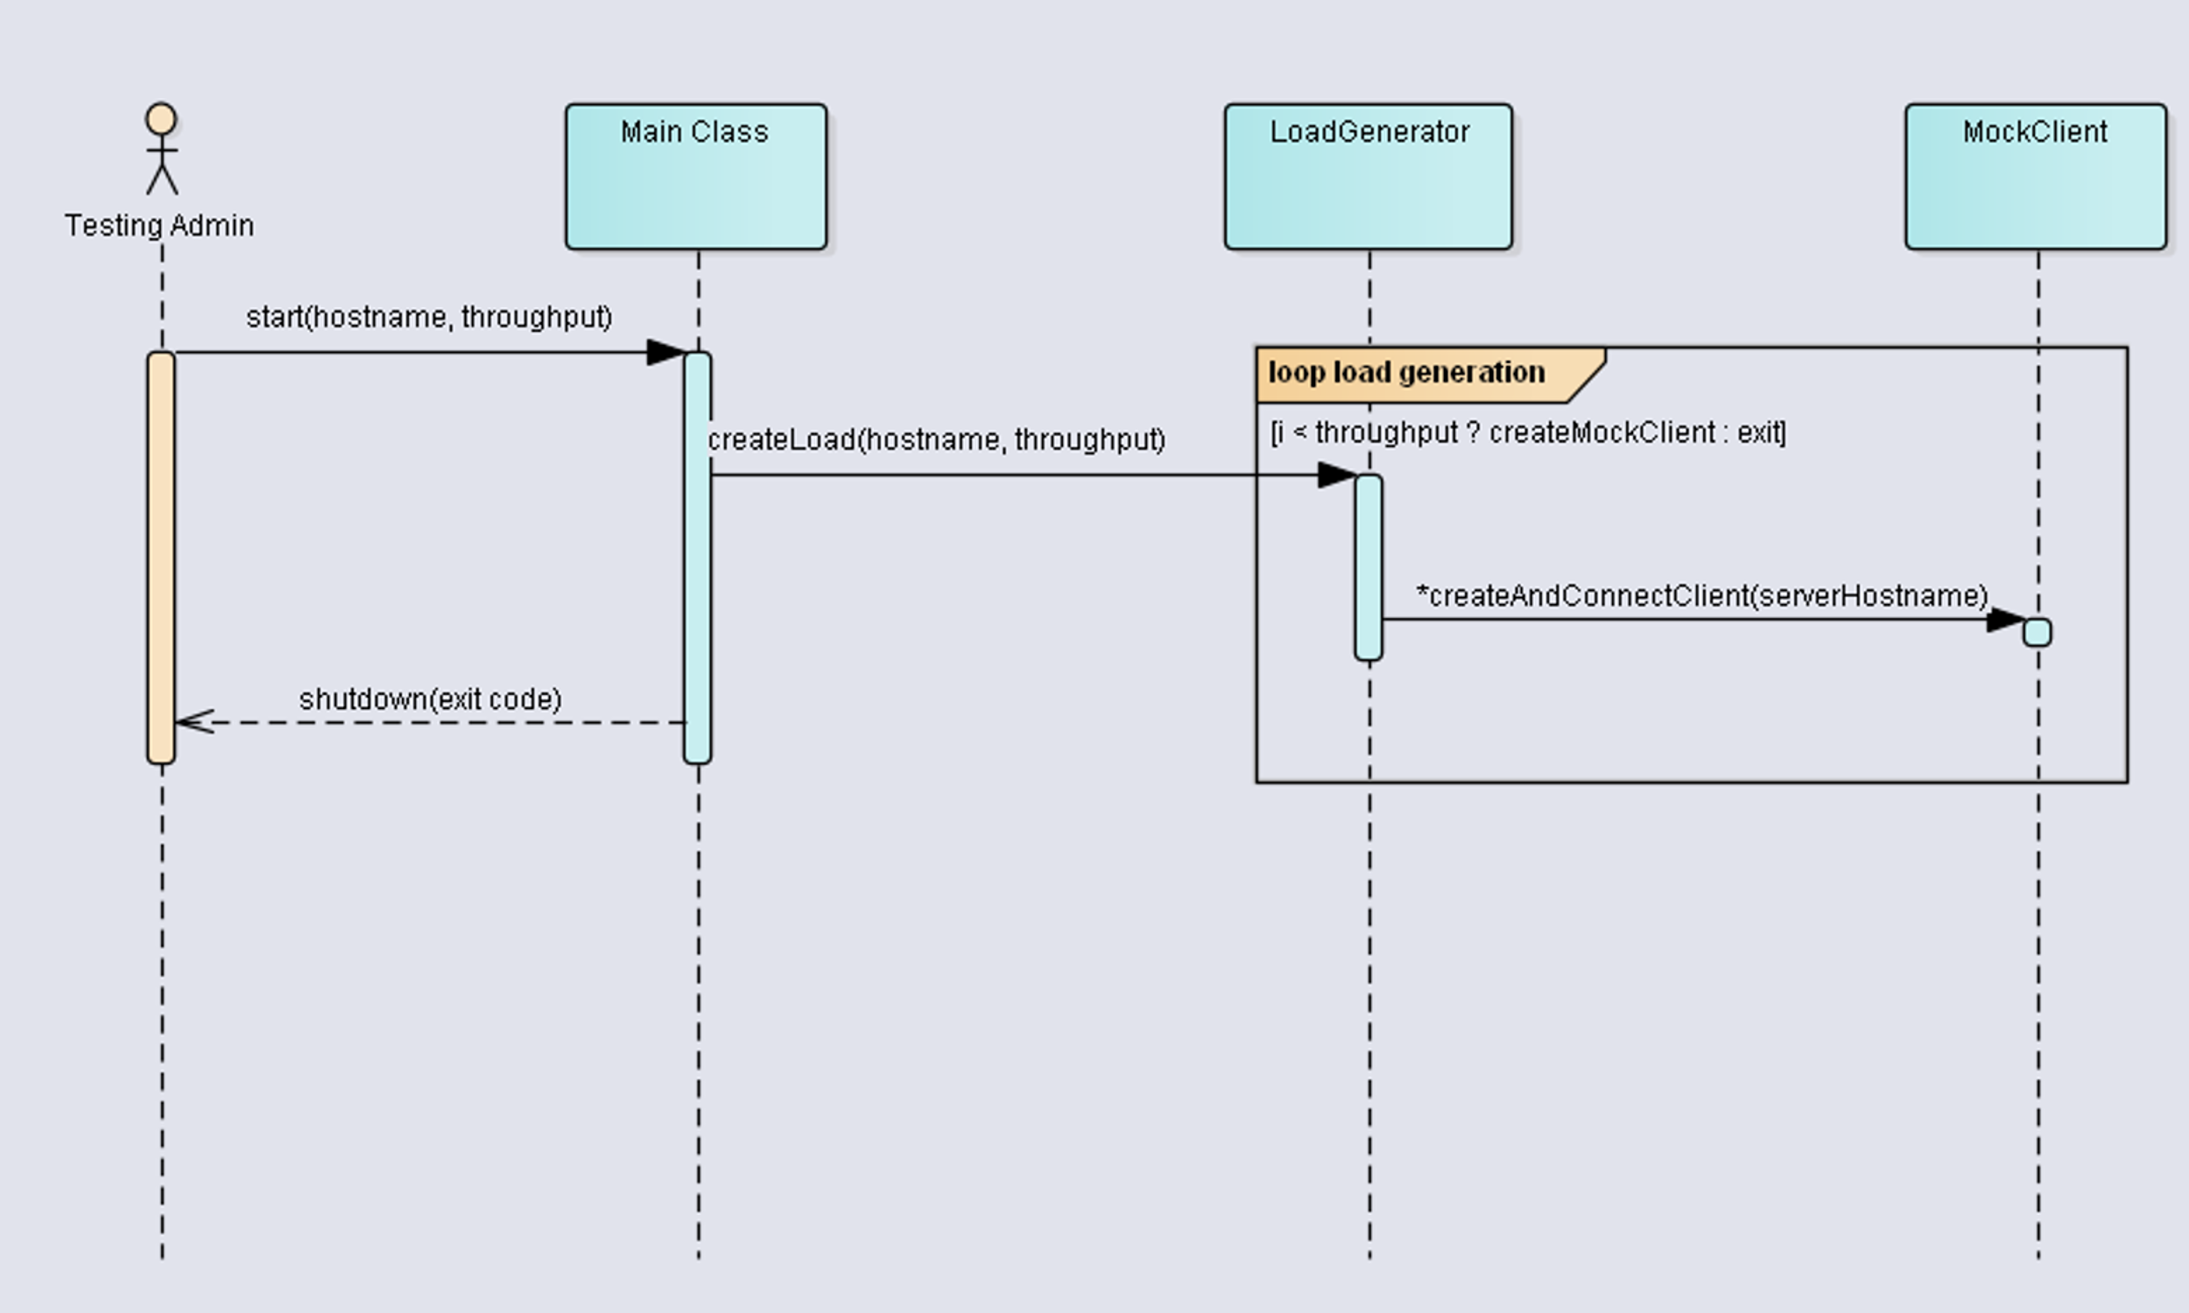
Load generation
For each of the interconnection type we generated load of approximately 50% system maximal throughput.
HTTP(sync) – 10 devices.
HTTP(async) – 90 devices.
gRPC – 170 devices.
RabbitMQ – 290 devices.
Load generation sequence diagram.

Slide 27
Load generation
For each of the interconnection type we generated load of approximately 50% system maximal throughput.
HTTP(sync) – 10 devices.
HTTP(async) – 90 devices.
gRPC – 170 devices.
RabbitMQ – 290 devices.
Load generation sequence diagram.
We repeat every test run 30 times to ensure more accurate results.

Slide 28
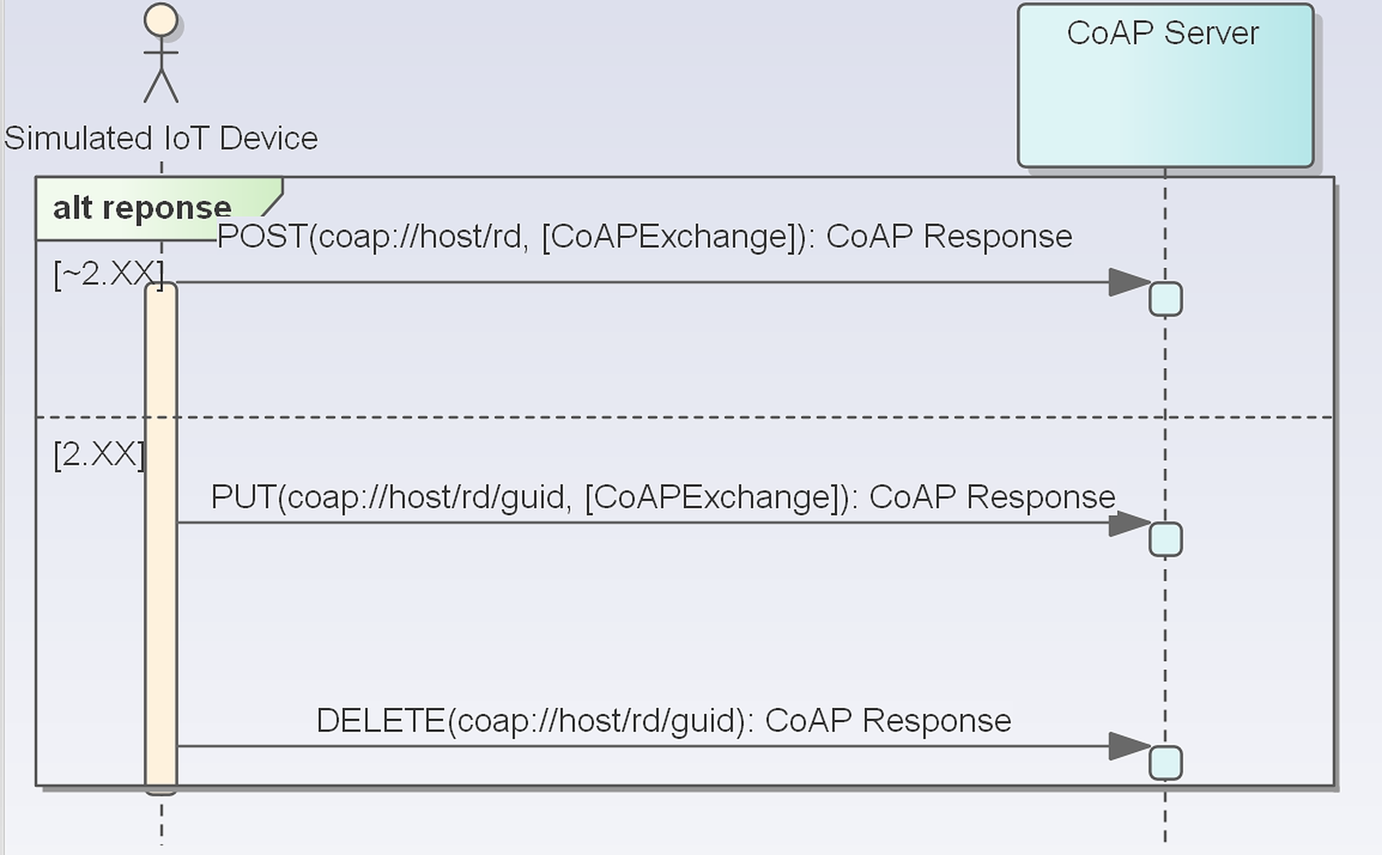
Silmulated IoT device
Requests:
POST – to save IoT device on the given host
PUT – to update information about IoT device on the given host
DELETE – to delete information about IoT device on the given host
Simulated IoT device lifecycle SD.

Slide 29
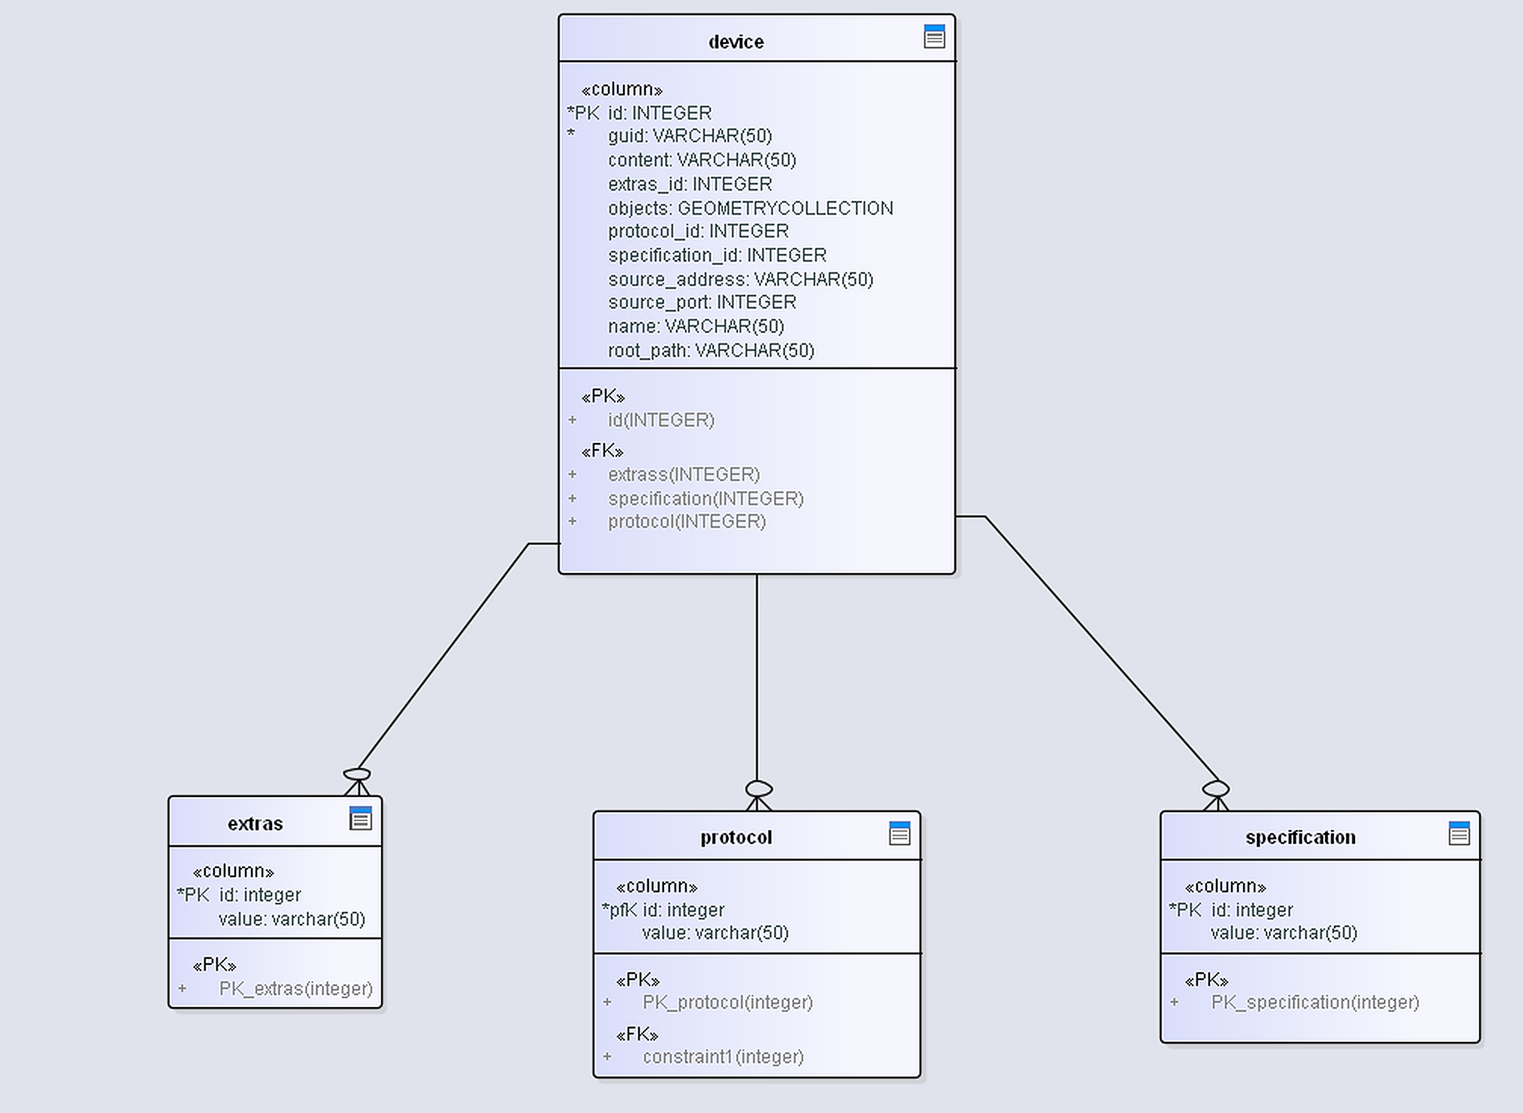
Registration data model
Simple session management
Contains a device description
Registration data model diagram.

Slide 30
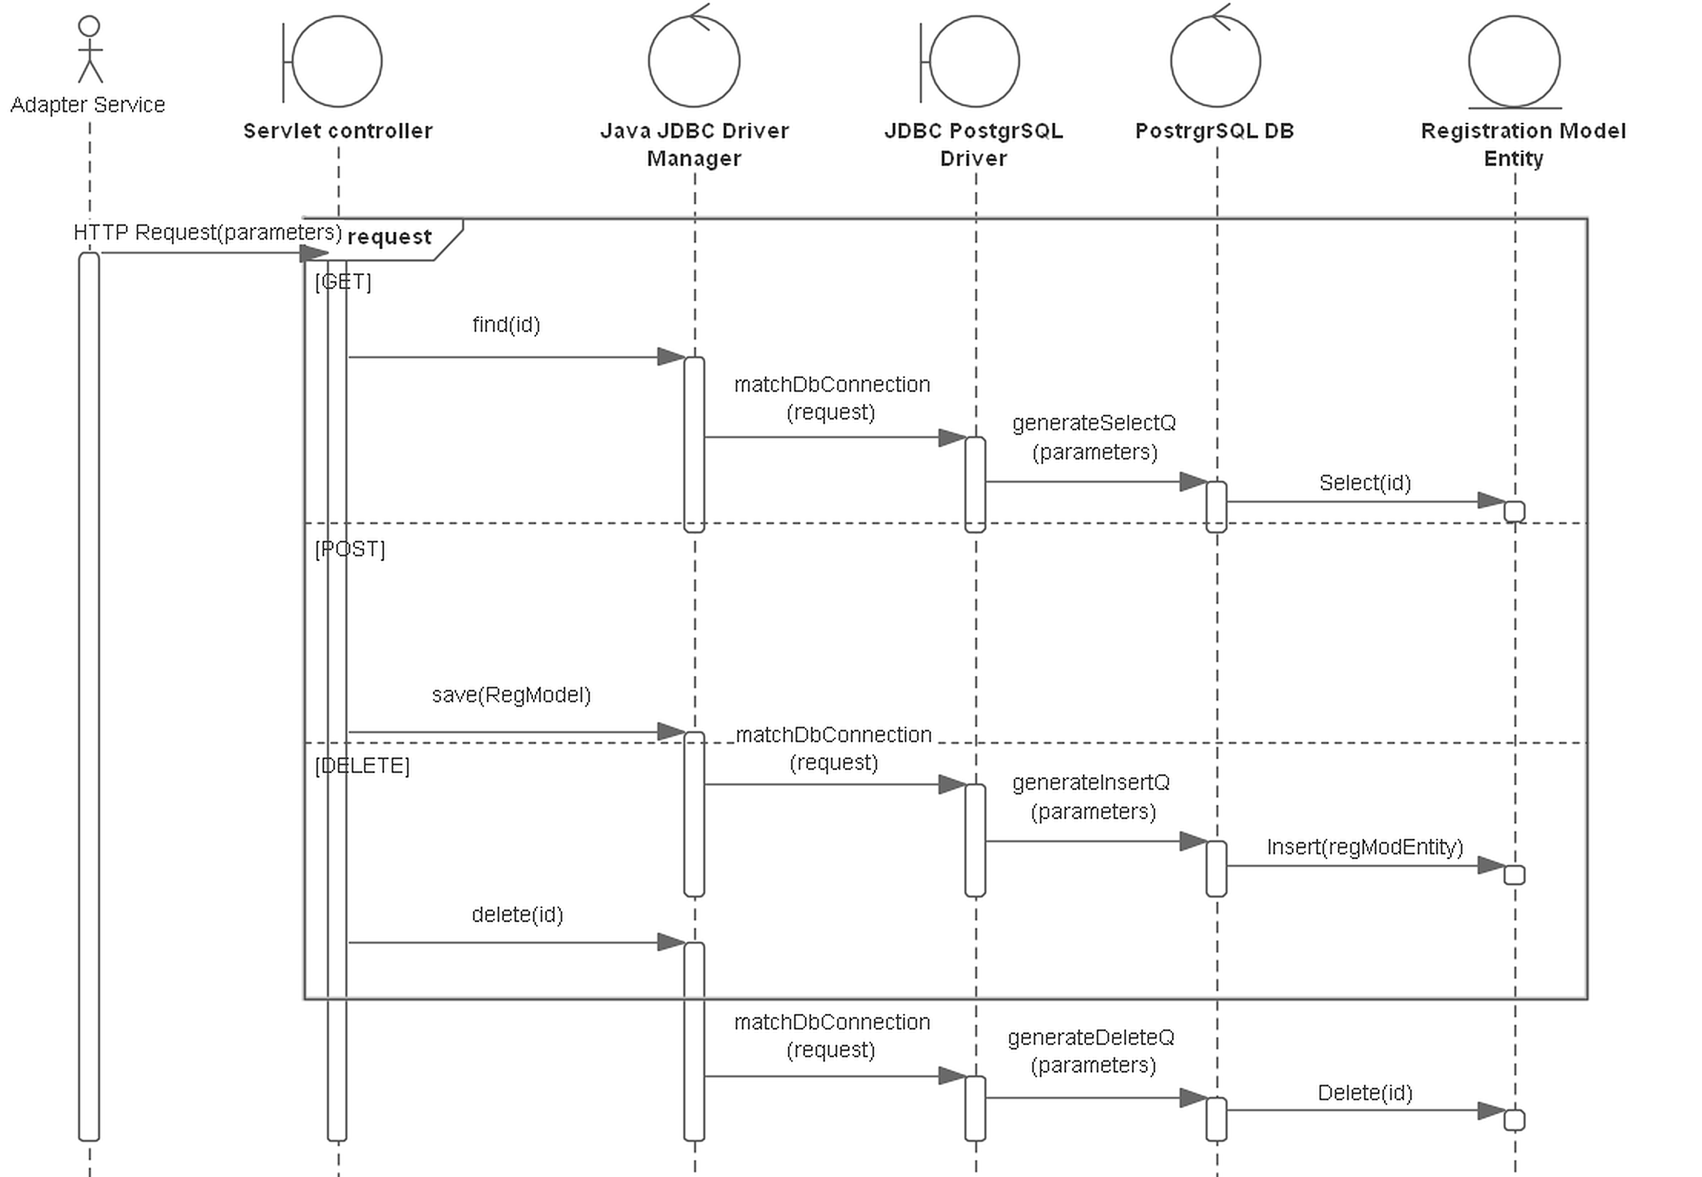
Registration persistence service
Processes device registration in the system.
Persists information about connected devices to the system.
Registration sequence diagram.

Slide 31
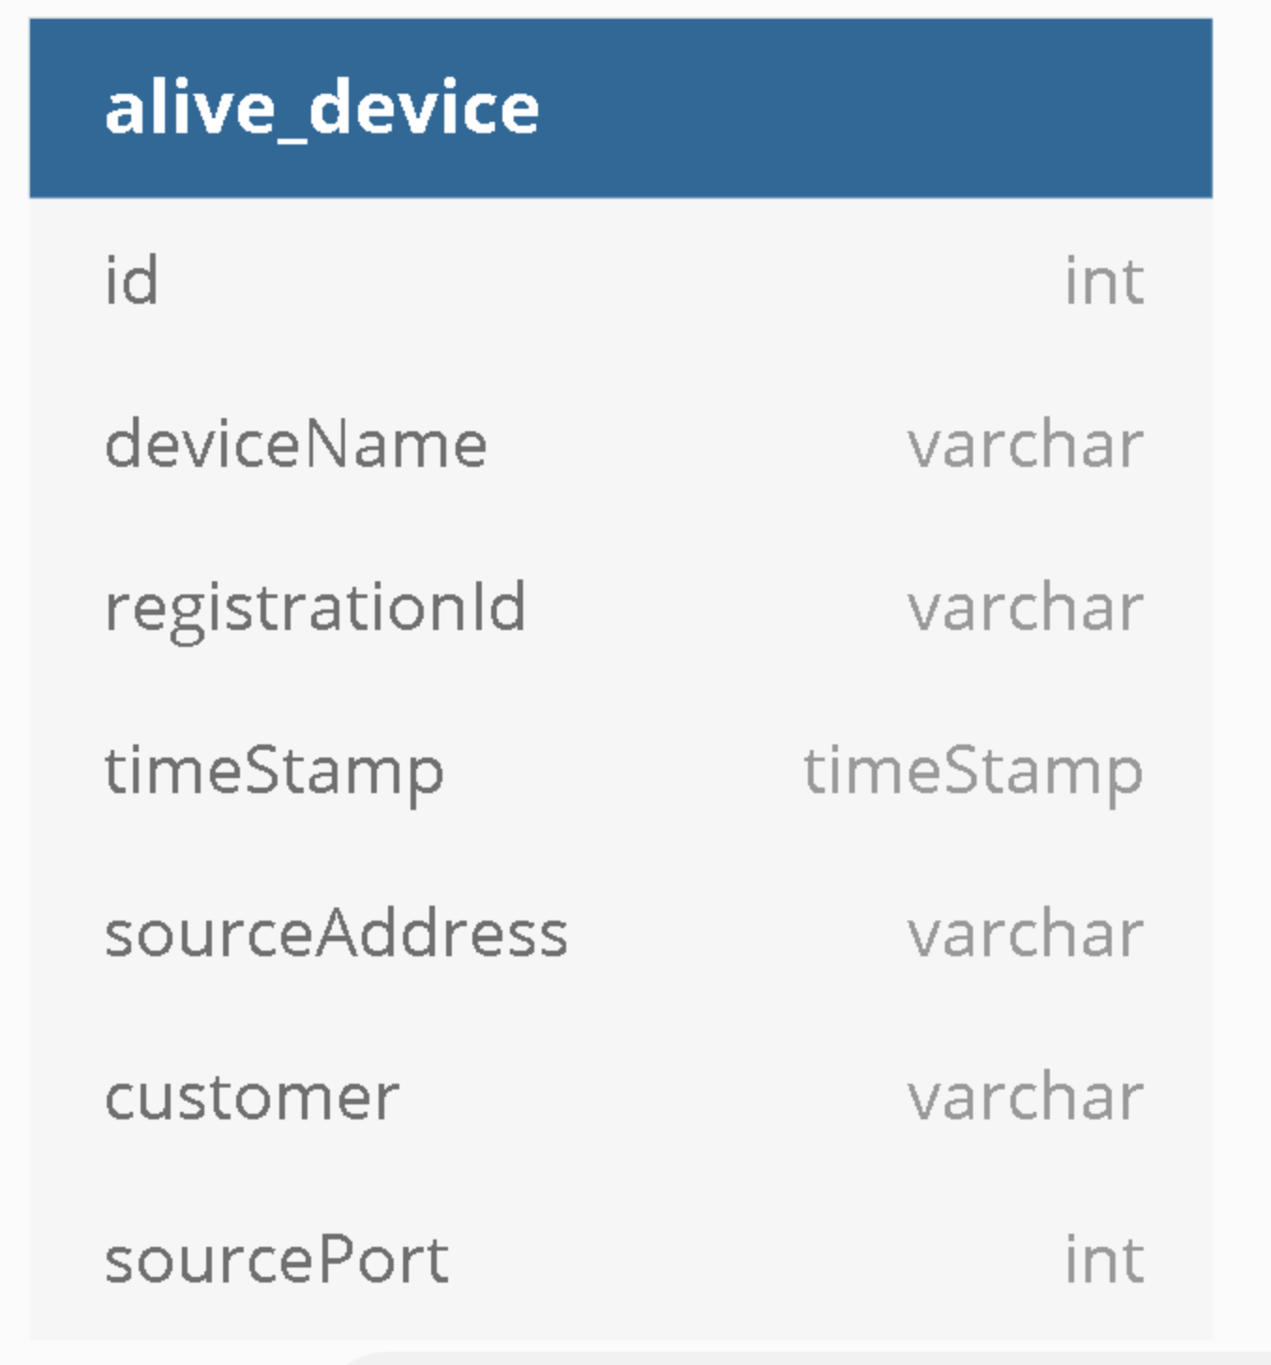
Alive devices model
Contains information about IoT devices current activity.
Alive device model diagram.

Slide 32
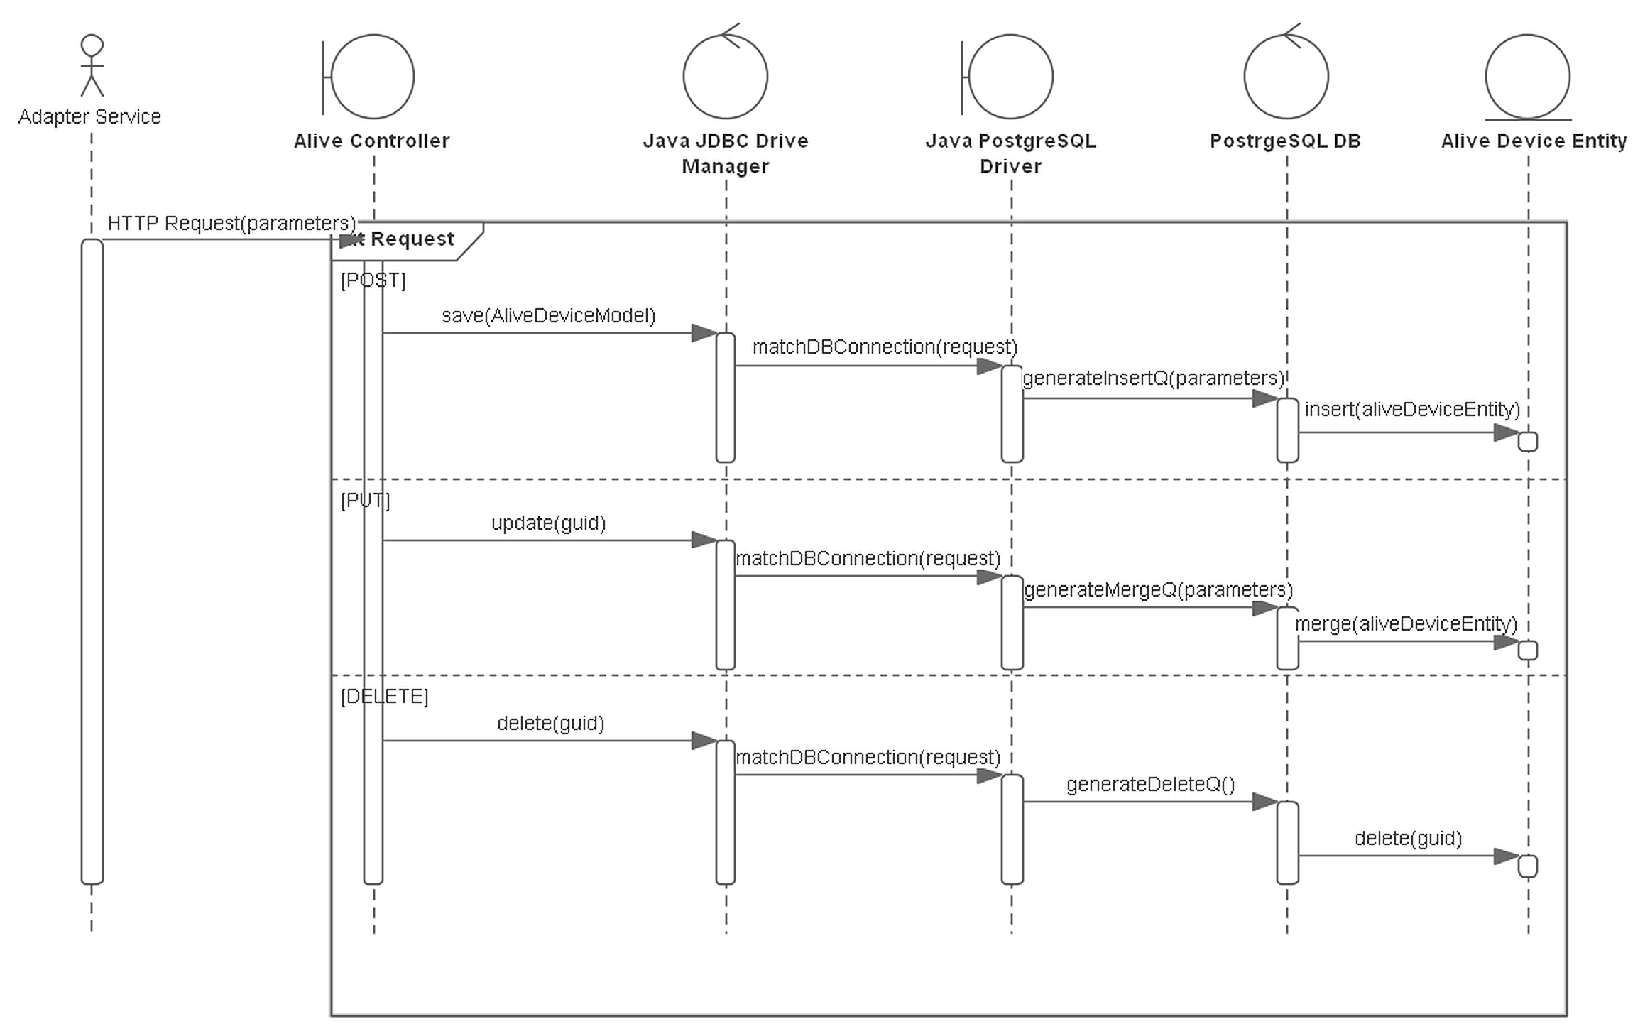
Alive devices service
Ensure alive device entity management
Alive devices service SD.

Slide 33
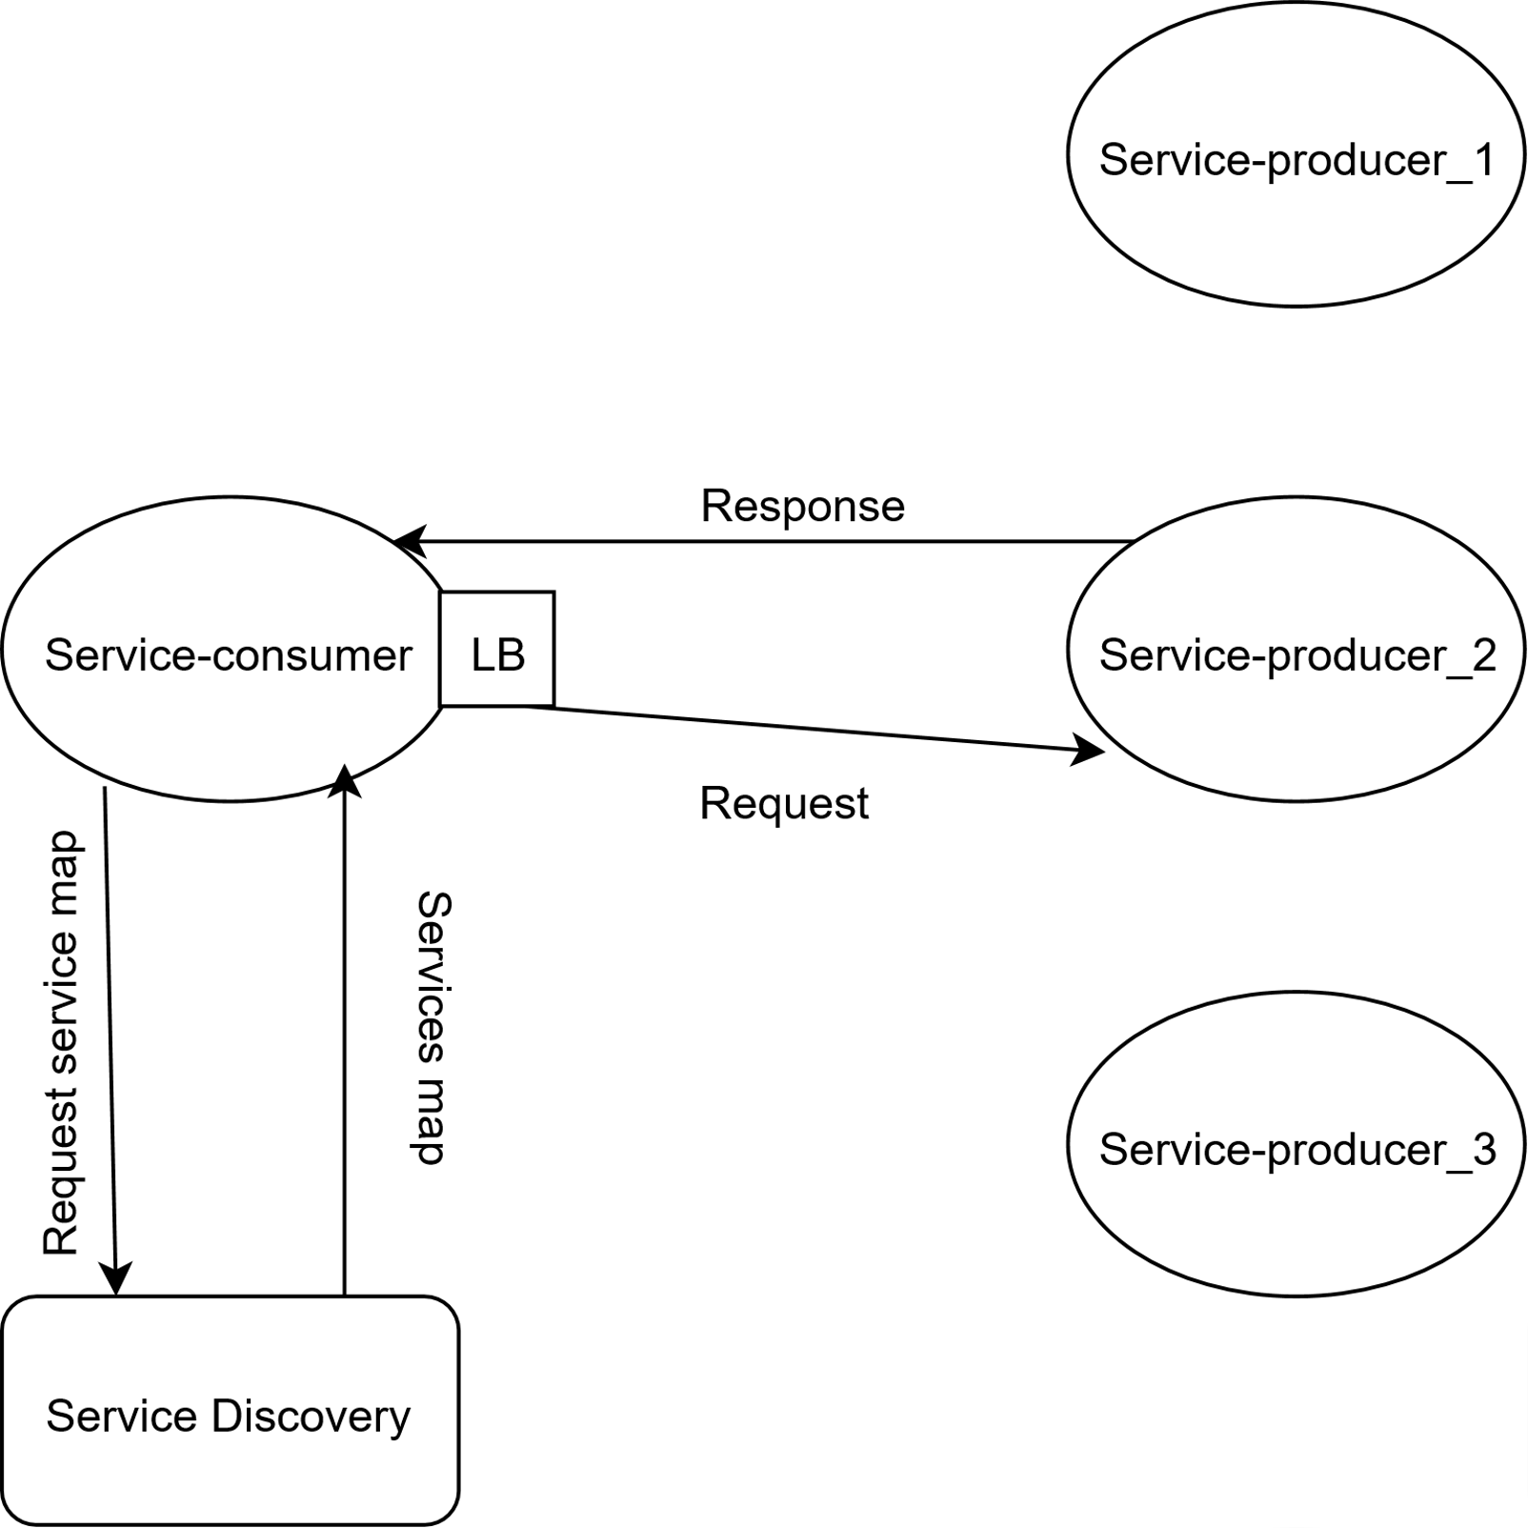
Client-side LB
Each service knows about other service instances.
Every service instance has to connect to service discovery.
Client-side LB diagram.

Slide 34
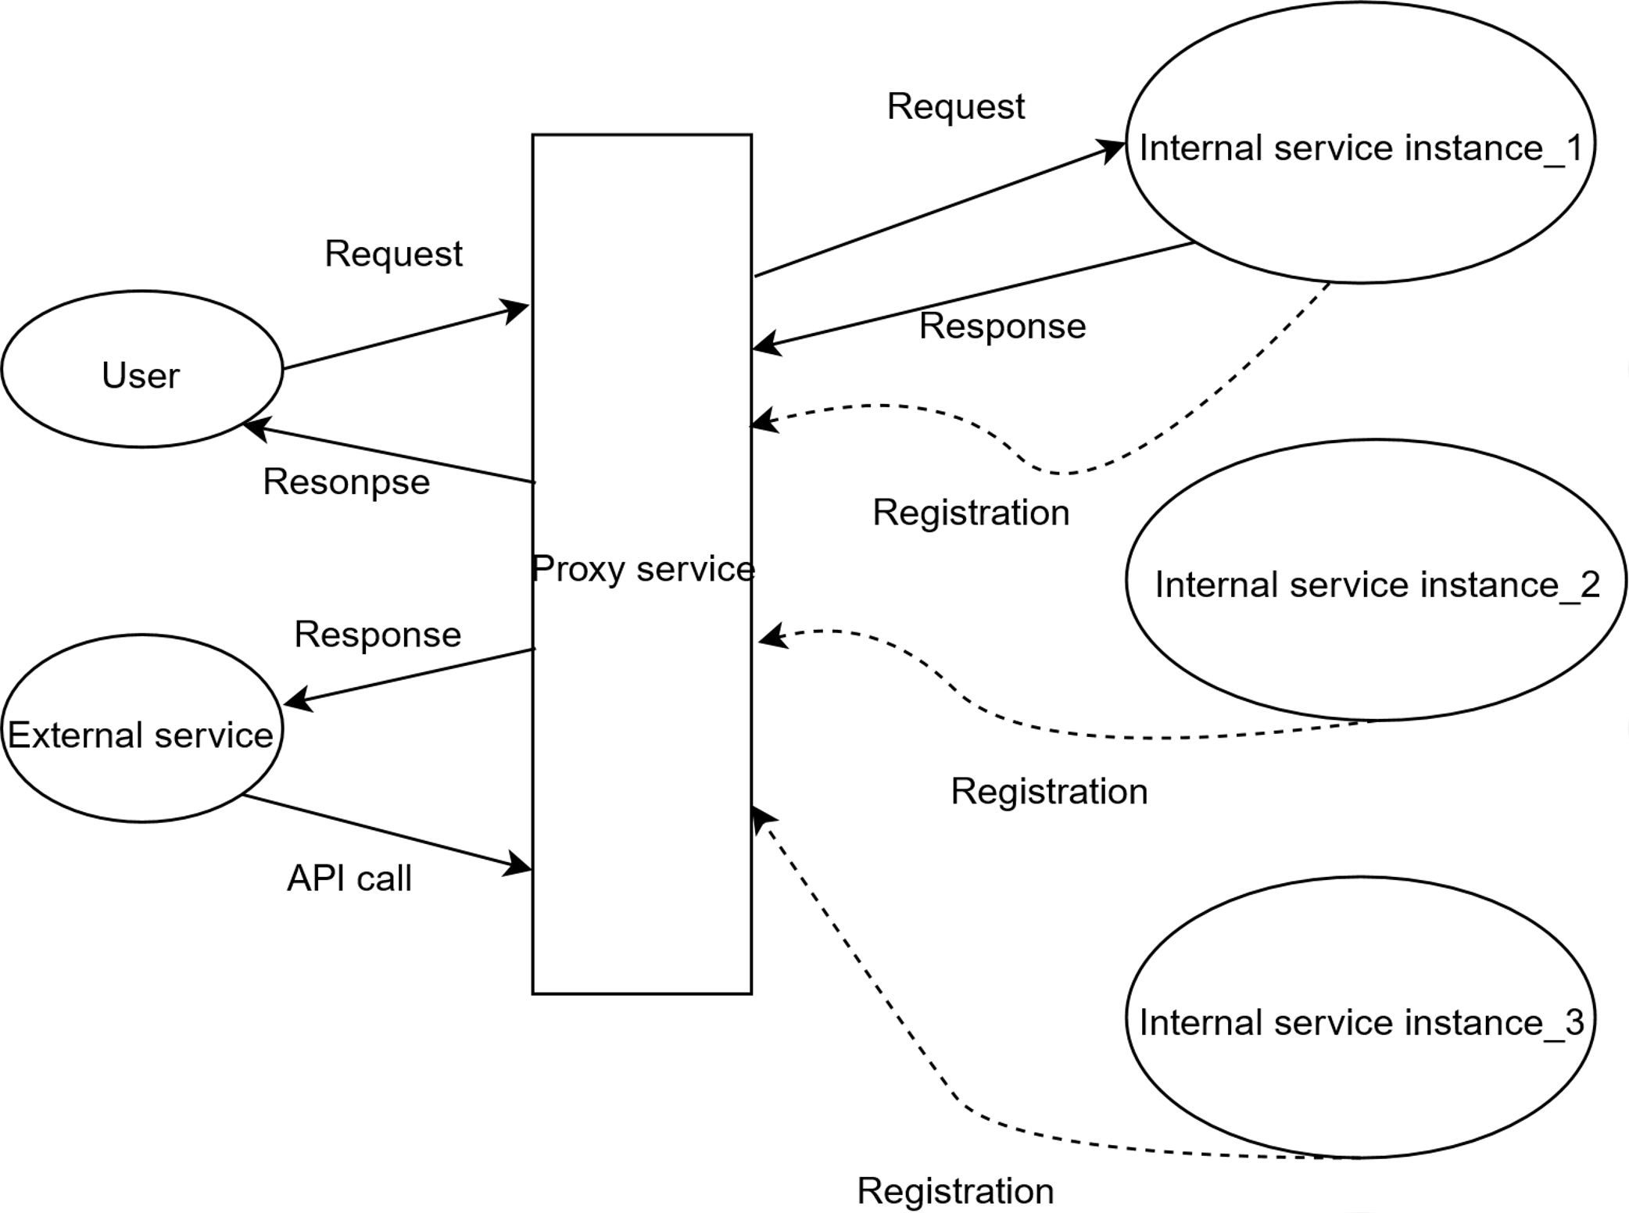
Server-side LB
Each service instance knows only URI of requesting service.
Every service instance has to connect to proxy/gateway service.
Server-side LB diagram.

Slide 35
Measuring system
To measure response time we used distributed tracing system.
We stored trace logs in document-oriented DB.
We used Elasticsearch engine to retrieve and analyze logs

Slide 36
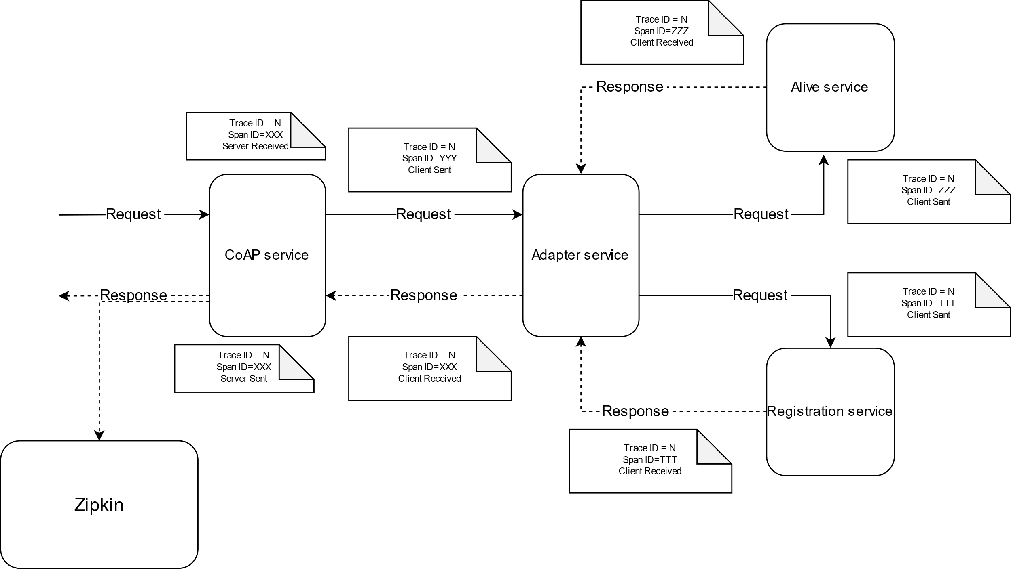
Measuring system
Measuring system diagram.

Slide 37
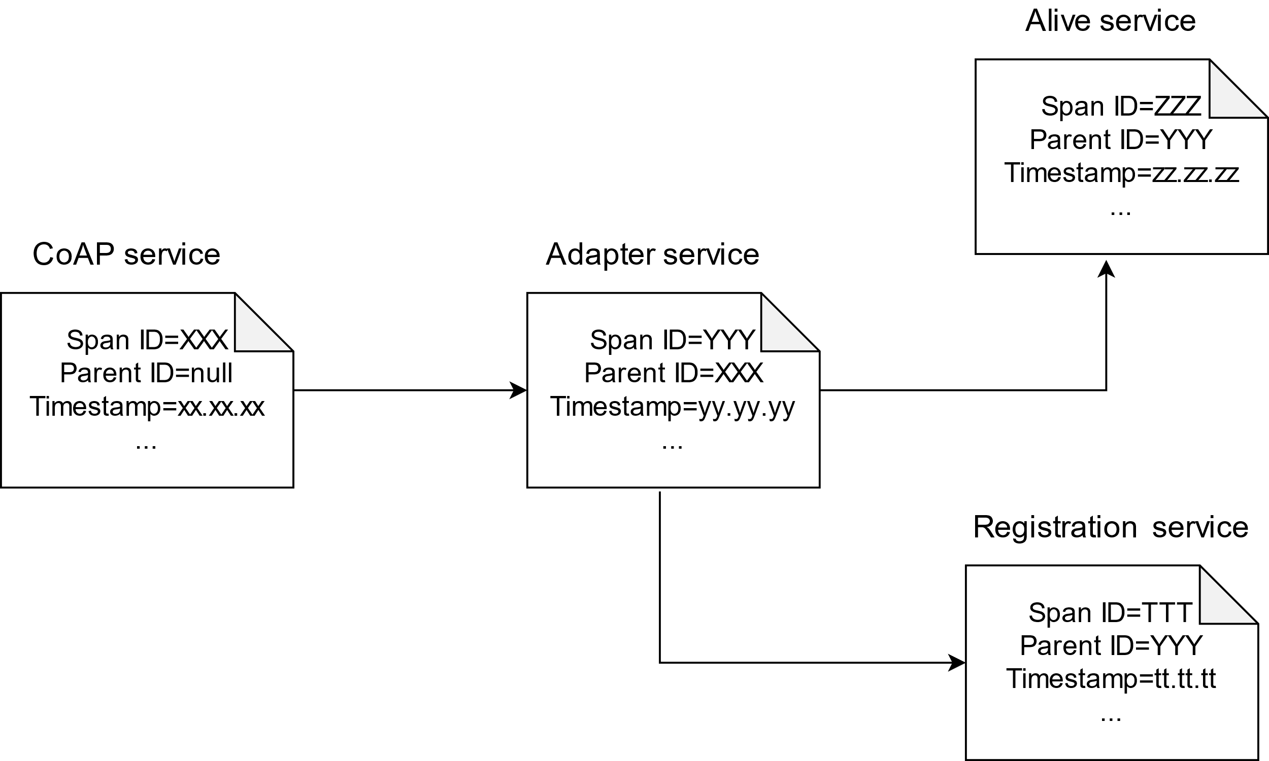
Measuring system
Each span contains:
Its ID
Trace ID
Parent ID
Timestamp
Duration
Endpoint info
Custom Tags
Span child-parent relationship diagram.

Slide 38
Results

Slide 39
Interconnection comparison
RabbitMQ provides the lowest response time of less than 1 millisecond.
Async. HTTP provides the highest response time, a bit higher 70 milliseconds.

Slide 40
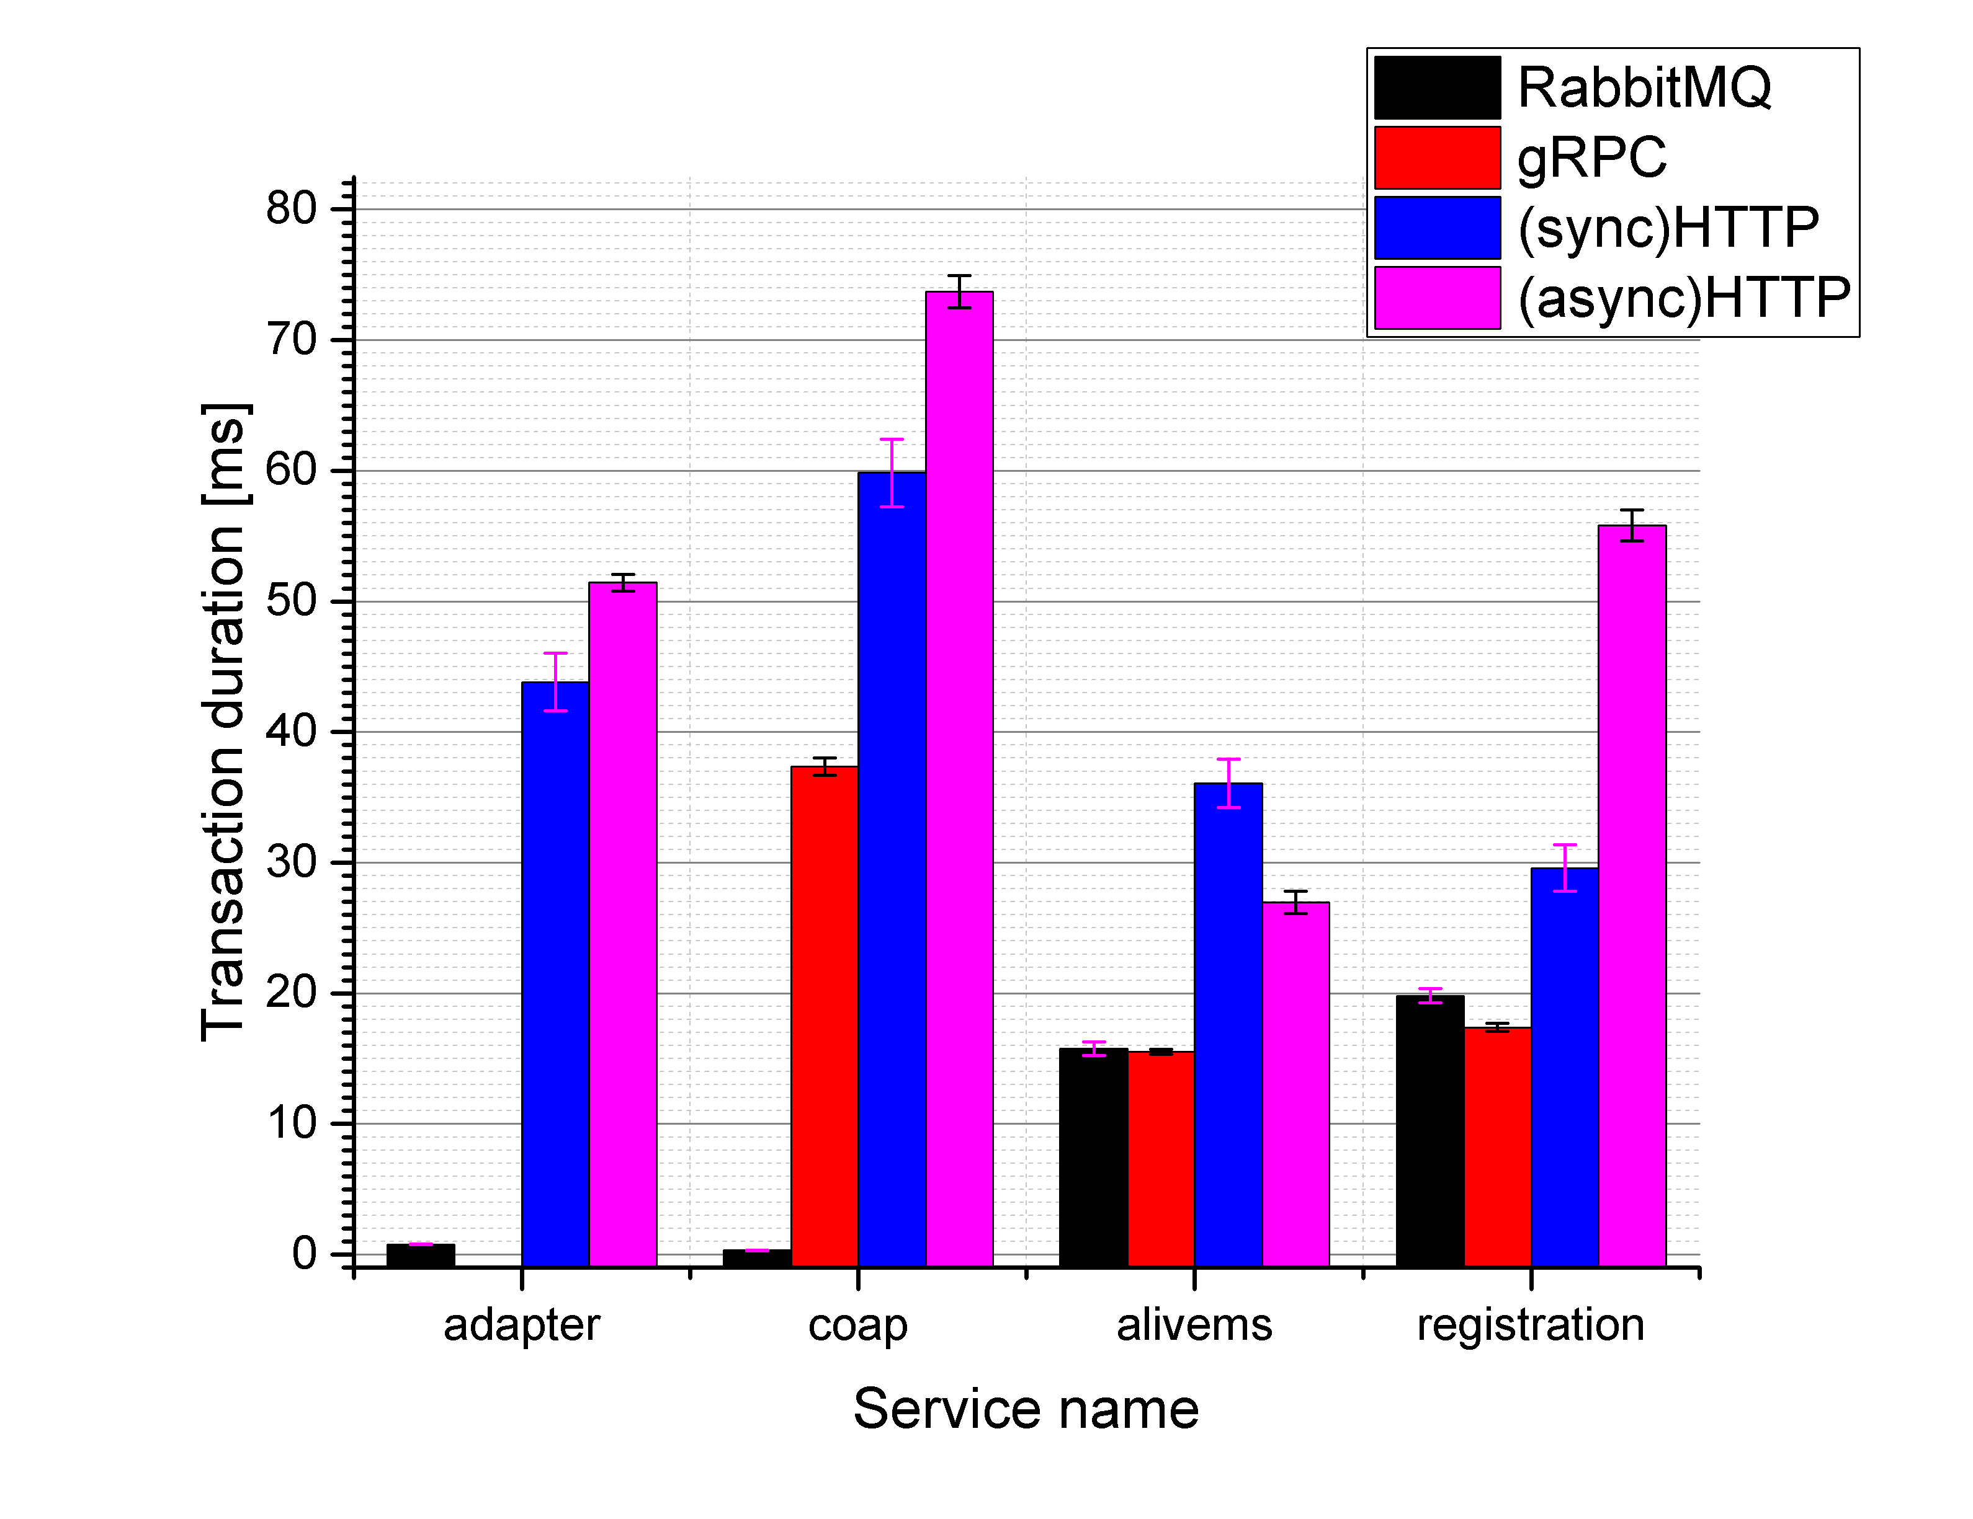
Transaction duration by service
gRPC interconnection provides lowest transaction duration time of the persistence services.
RabbitMQ provides the lowest transaction duration time of the non-persistence services.

Slide 41
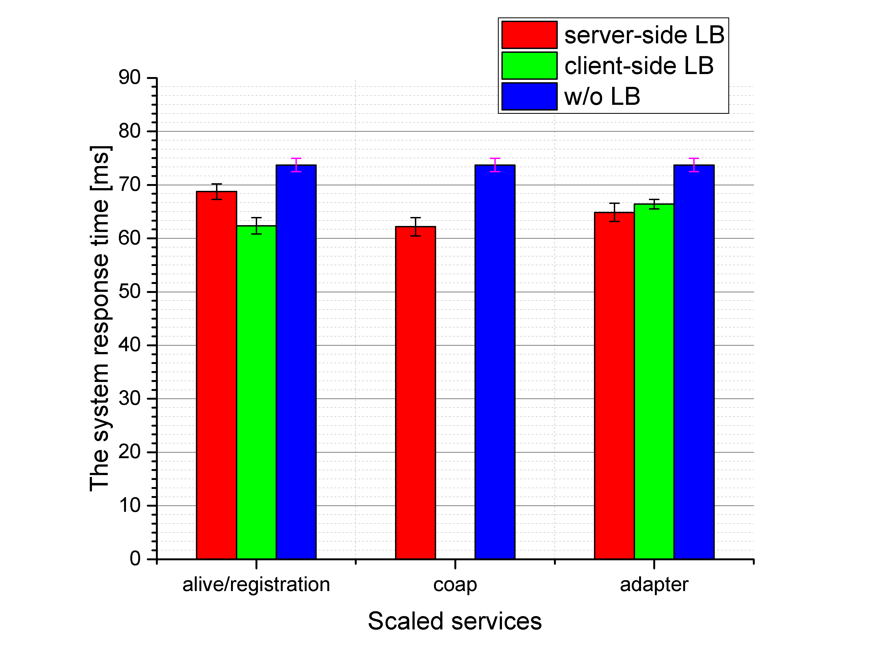
Load balancing strategies comparison
Client-side LB strategy provides about 10% less a system response time, scaling persistency services.
Server-side LB strategy improves the system response by almost the same amount but by scaling edge service.

Slide 42
LB Impact on services
Server-side LB provides slightly faster response time.

Slide 43
DBMS comparison
Key-Value DBMS requires significantly less time to execute database operations.
To process a random DB operation, it needs 8 milliseconds, approximately.

Slide 44
Conclusion

Slide 45
Conclusion
Connect non-persistence services via RabbitMQ and persistence services via gRPC.
Document-oriented DBMS can ensure the lowest transaction duration of persistence services.
Load balancing strategy choice depends on which service has to be scaled. Also, server-side one provides a little faster response time.

Slide 46
Future work
To test the microservice system with some additional services satisfying more realistic requirements.
Improve the load generator.
Survey about how caching might affect the system response time.
Prove our research for production usage.

Slide 47
Thank you for your attention

